Slide 1
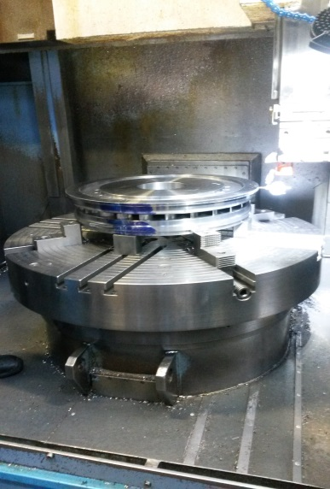
HS&E INCIDENT BULLETIN |  | 1st half year 2017
Le Havre, France | Type of incident (Ankle Fracture – Struck By)
Summary:
An operator was working on a vertical lathe. He hit his right ankle on a lifting ring attached to the machine table when he was walking around the table to set up the lathe. He immediately went to the infirmary and then to the hospital for an x-ray. He suffered an ankle avulsion fracture of the malleolus (side ankle bone) and is expected to miss at least 10 days of work due to the injury.
Root Causes: | Actions Taken Thus Far: Next Steps
Machine design. The presence of a lifting ring is used only to move the machine, which is a very rare operation. Risk of hitting the lifting ring was not identified nor reported by operators even though it has been present since the installation of the machine. | Awareness/review was done for all applicable operators. Review all similar activities in all workshops. First immediate actions include paint (for awareness) or add protection to this and other similar lifting rings. Installation of new contact protection on the lifting rings for the three machines affected.

